Slide 1
County-Level Unemployment Rates in the United States
AKHIL SACHAR
ARASH AHMADI

Slide 2
Overview
Introduction
Data Sources & Variables
Exploratory Data Analysis (EDA)
Model Development & Diagnostics
Results & Interpretation
Limitation & Future Steps
Q&A
Glossary
Appendix

Slide 3
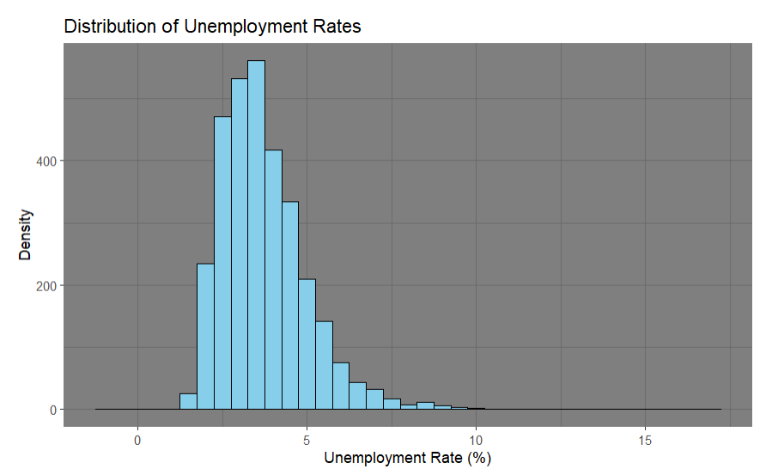
Introduction
Unemployment = Percentage of labor force actively seeking work
Why it matters: Key measure of economic and social health
Local (County) level reveals important regional economic disparities
County income and budget
Housing prices and local market
Objective: Build a model to identify drivers of county unemployment (2023)
Notes:
Unemployment is one of the most widely watched measures of economic health, but behind national averages, local realities can vary dramatically."
By focusing at the county level, we can uncover deeper patterns and better understand the social and economic, and environmental factors that drive unemployment in different parts of the country.
Lower county income → lower consumer spending → weaker local businesses → potential further job loss.
Housing prices
Income
This project uses a multiple linear regression approach to explore these relationships and to identify which factors are most closely associated with variations in unemployment across regions."

Slide 4
Data Sources & Variables
US Department of Agriculture - USDA
Poverty Rate
Median Household Income
Total Population
US Bureau of Labor Statistics
Unemployment Rate
County Health Rankings & Roadmaps
Health Data
Life Expectancy
US Census Bureau
County Population
Number of Death
Notes:
Economic: Median income, poverty rate, cost of living
Social: Uninsured percentage, crime rate, education level
Environmental: Water quality, air quality, park score

Slide 5
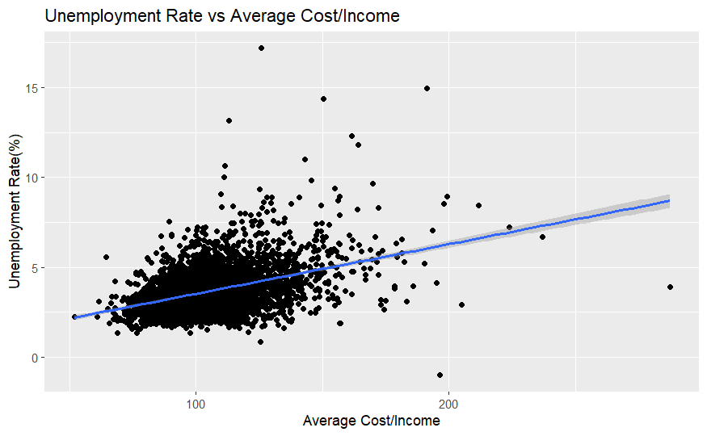
Cost-to-Income Ratio vs Unemployment
Reflects local affordability
Handling multicollinearity of living cost and median income
Positive association: as cost increases relative to income, unemployment tends to rise
When living cost outpace income may experience greater economic instability, job loss, or worker migration
Notes:
"The cost-to-income ratio reflects local affordability — how expensive it is to live relative to typical earnings."
"We observe a positive association: as cost pressures increase relative to income, unemployment tends to rise."
"Counties where living costs outpace incomes may experience greater economic instability, job loss, or worker migration."

Slide 6
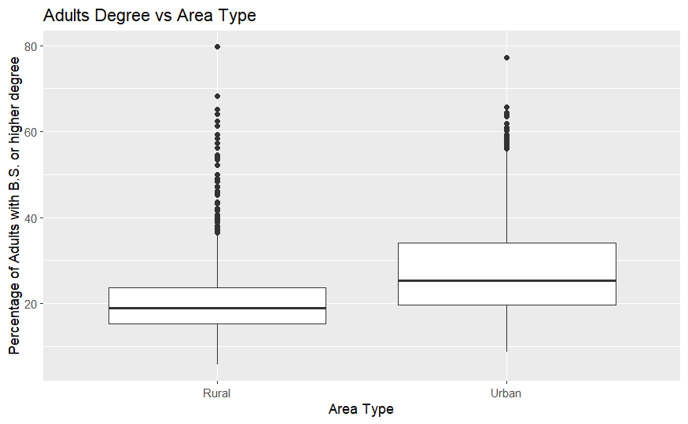
Urban vs Rural Percentage of B.S.
Urban:
Median: 27%
IQR: [20 – 33]
Rural
Median: 19%
IQR: [17 – 25]
Urban counties generally have a higher percentage of residents with a bachelor's degree compared to rural counties
IQR: Interquartile range(25th Percentile – 75th Percentile)
Notes:
"Urban counties generally have a higher percentage of residents with a bachelor's degree compared to rural counties."
"Higher educational attainment often correlates with lower unemployment rates and more diversified local economies."
"Educational disparities between urban and rural areas may partly explain regional differences in unemployment patterns."

Slide 7
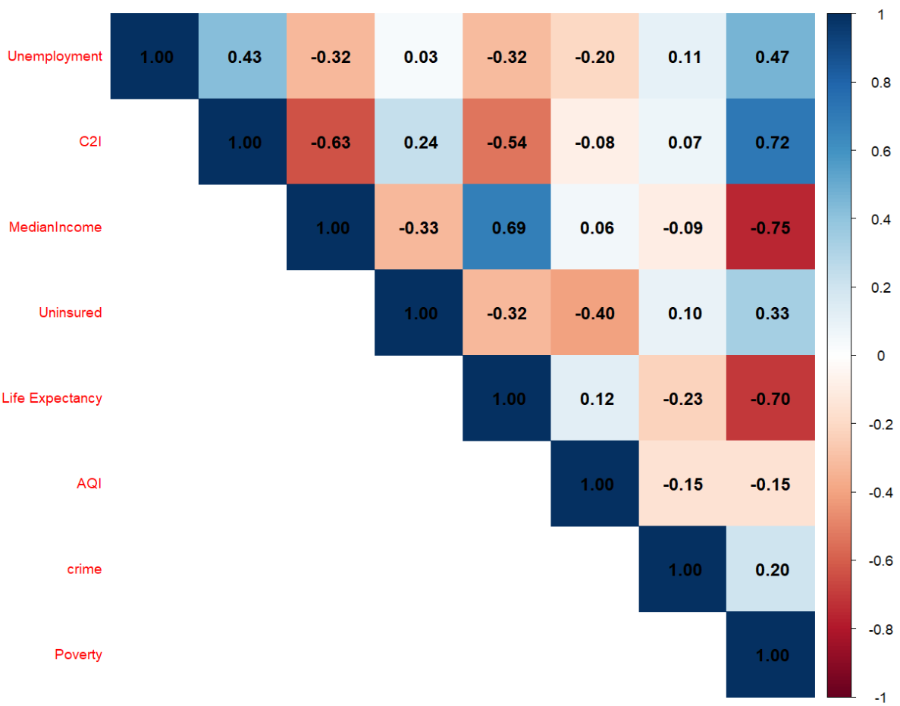
Correlation Matrix
Unemployment has moderate positive correlations with Poverty (0.47) and C2I (0.43).
MedianIncome has strong negative correlation with Poverty (–0.75) and C2I (-0.63), additionally having strong positive correlation with Life Expectancy (0.69).

Slide 8
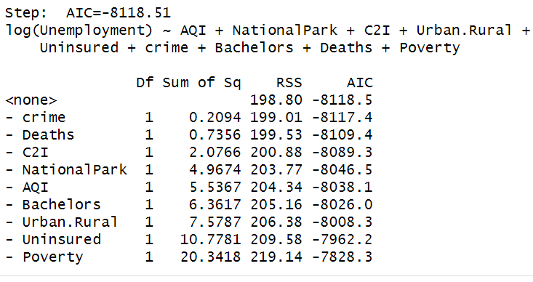
Step-Wise AIC
Running step-wise AIC to create a reduced model.

Slide 9
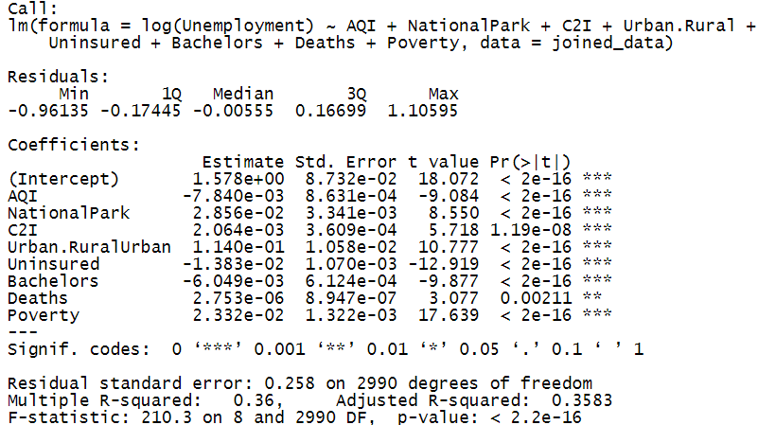
Final Linear Model

Slide 10
Multicollinearity (VIF)
All VIF values are well below the common threshold of 5, indicating that multicollinearity is not a concern in the final model. The highest VIF is for Poverty (2.38) and C2I (2.20) though relatively higher, they are still acceptable.

Slide 11
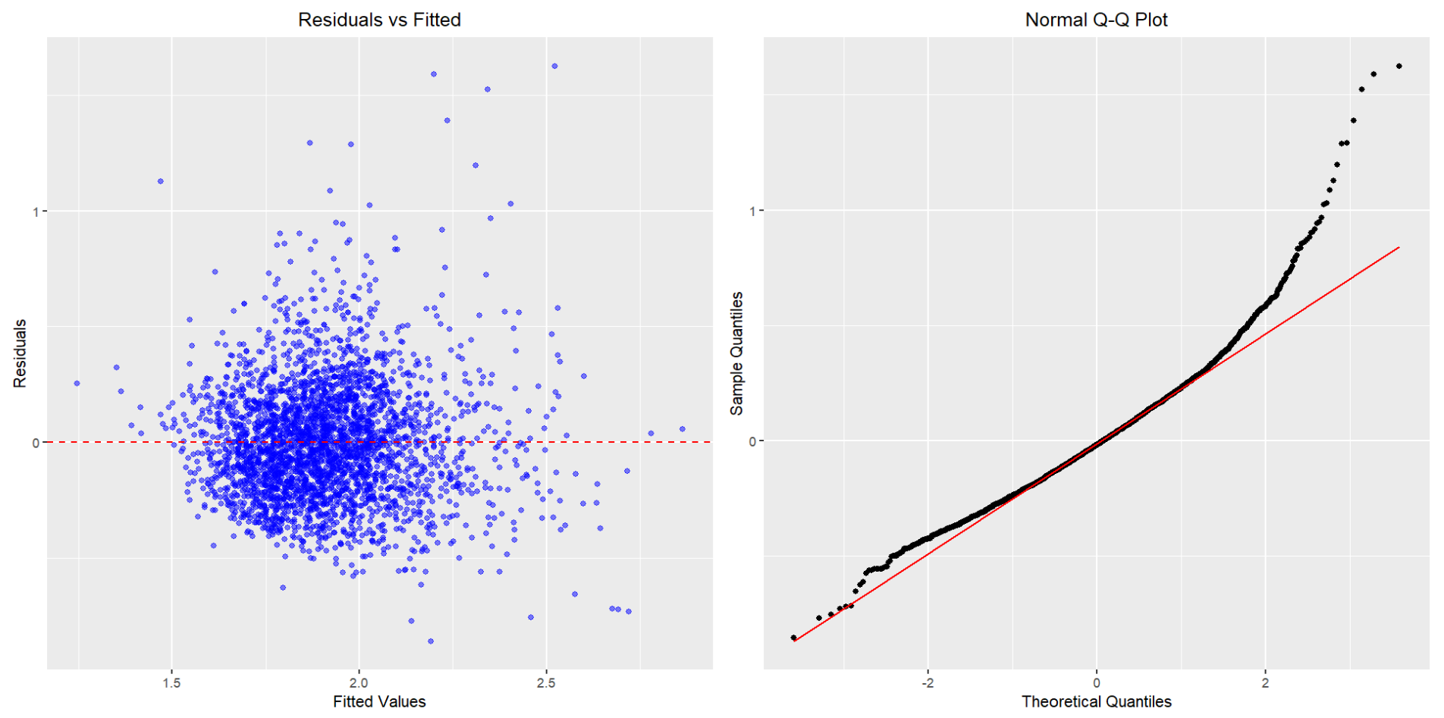
Checking Assumptions

Slide 12
Results & Interpretation
log(Unemployment) = 1.57809 + -0.00784 * AQI + 0.02856 * NationalPark + 0.00206 * C2I + 0.11401 * Urban.RuralUrban + -0.01383 * Uninsured + -0.00605 * Bachelors + 0.000002753 * Deaths + 0.02332 * Poverty
Each coefficient shows an approximate percentage change in Unemployment for a one-unit increase in the predictor
Unemployment increases with higher NationalPark presence, C2I, living in Urban areas, Poverty rates, and very slightly with Deaths.
Unemployment decreases with higher AQI, a greater percentage of Uninsured individuals, and more people holding Bachelor's degrees.

Slide 13
Limitations & Future Steps
Limitations
Data integration
Require extensive cleaning and harmonization across multiple sources
Missing values and inconsistent data(2% data dropped)
Limited availability of Minimum Wage Data(County level)
Moderate Adjusted R-squared
Reflects the complexity of human behavior and local economic shocks
Future Steps:
Expand predictors set
Housing prices, average wage and industry employment composition
Gender and ethnicity data
Enhance model complexity by exploring advanced modeling (e.g., LASSO, Ridge regression)
Experiment with alternative modeling approaches (e.g., Neural network, decision tree, random forest)

Slide 14
Q&A

Slide 15
Glossary
Employment and Unemployment:
People with jobs are employed.
People who are jobless, looking for a job, and available for work are unemployed.
The labor force is made up of the employed and the unemployed.
People who are neither employed nor unemployed are not in the labor force.

Slide 16
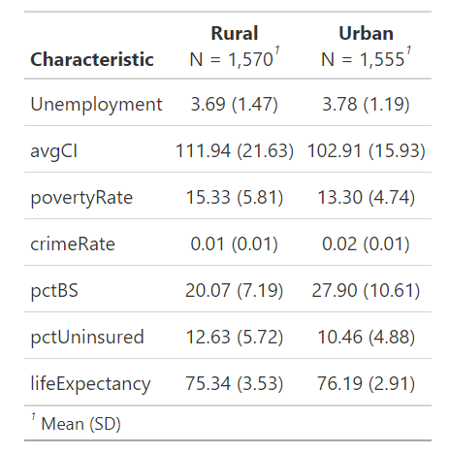
App 1: Summary Statistics & Key Features

Slide 17
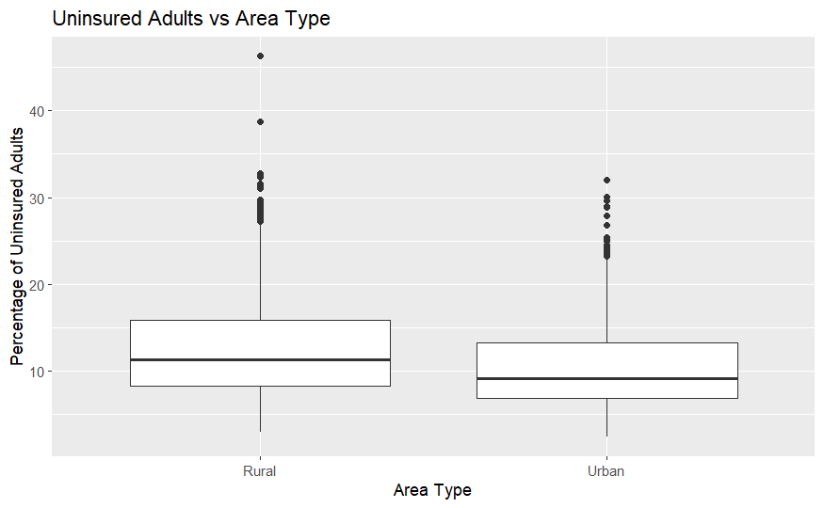
App 2: Urban vs Rural Uninsured Percentage

Slide 18
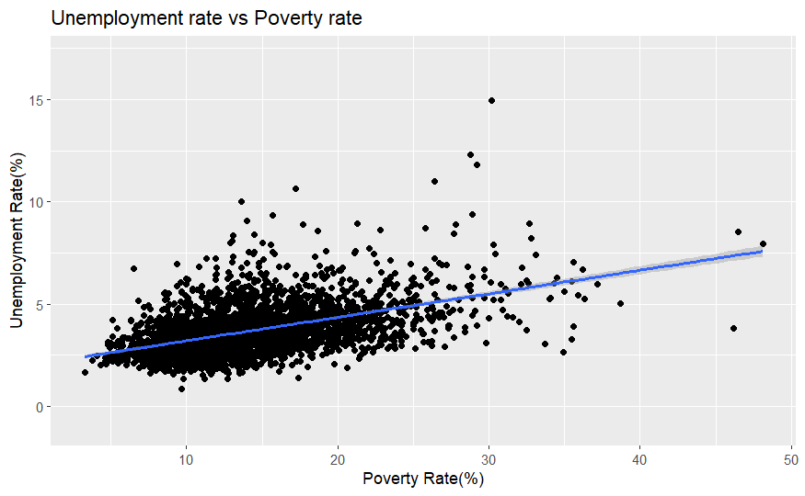
App 3: Poverty Rate vs Unemployment

Slide 19
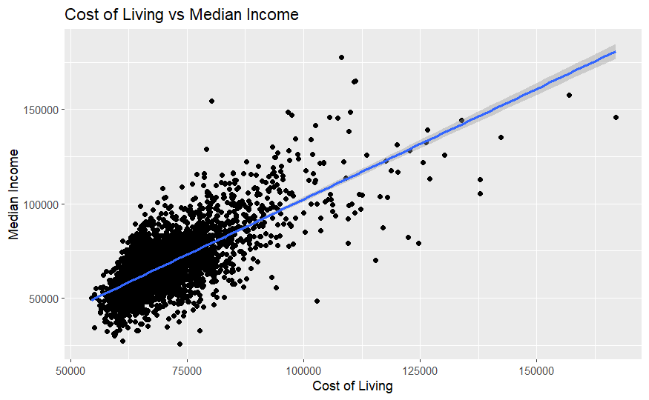
Appendix 4: Cost of Living vs Median Income

